Slide 1

SIRME
Sistema Integral de Revisión y Mantenimiento de Equipos
Integral System for Equipment Revision and Maintenance

Slide 2
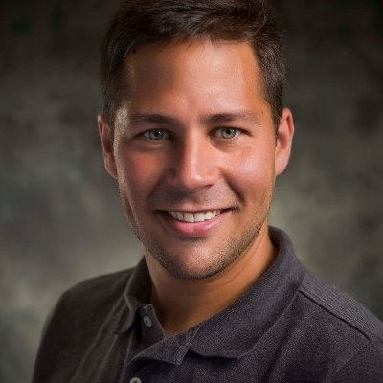


HELLO!
Álvaro Alcedo Moreno
Geek
Sports - Running
Ireland
Working & Studying
@ganzux
alvaro@alcedomoreno.com

Slide 3
Summary
Introduction
Objectives
Technologies
Design
Conclusions
Future Work
Demo?
Questions
Goals
Summarise the work I have been doing for the past few months.

Slide 4
Introduction
Observation of maintenance companies...
A lot of paper
Work repeated: technicians and office workers
SLOW EXPENSIVE!
There MUST be something I can do there...

Slide 5

Introduction
On the field
Revision - Annotation
Data exchange
Think... INFORMATION TECHNOLOGY
Use technology to exchange information
Centralize data

Slide 6
2. Objectives
AGILE: make the work faster
Less paper
Information easy to find and manage
Manage the business everywhere

Slide 7





















3. Technologies

Slide 8
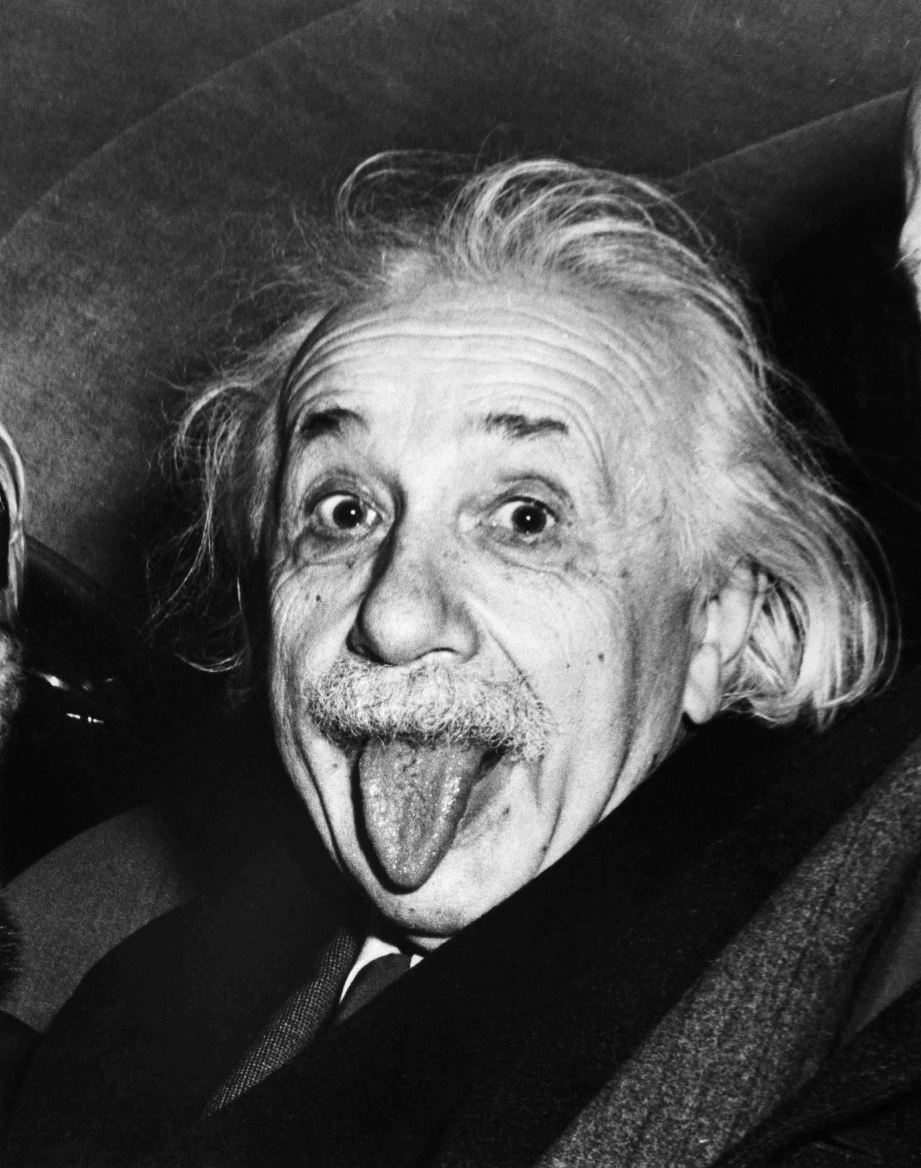
4. Design
Everything should be made as simple as possible, but no simpler.
Albert Einstein

Slide 9
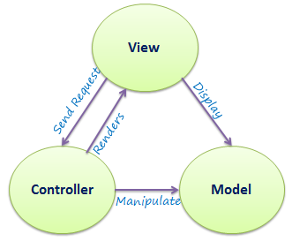
4. Design - Basics
MVC
3-tier / N-tier
REST
Jasper Reports
Utilities
Compression
Save images

Slide 10
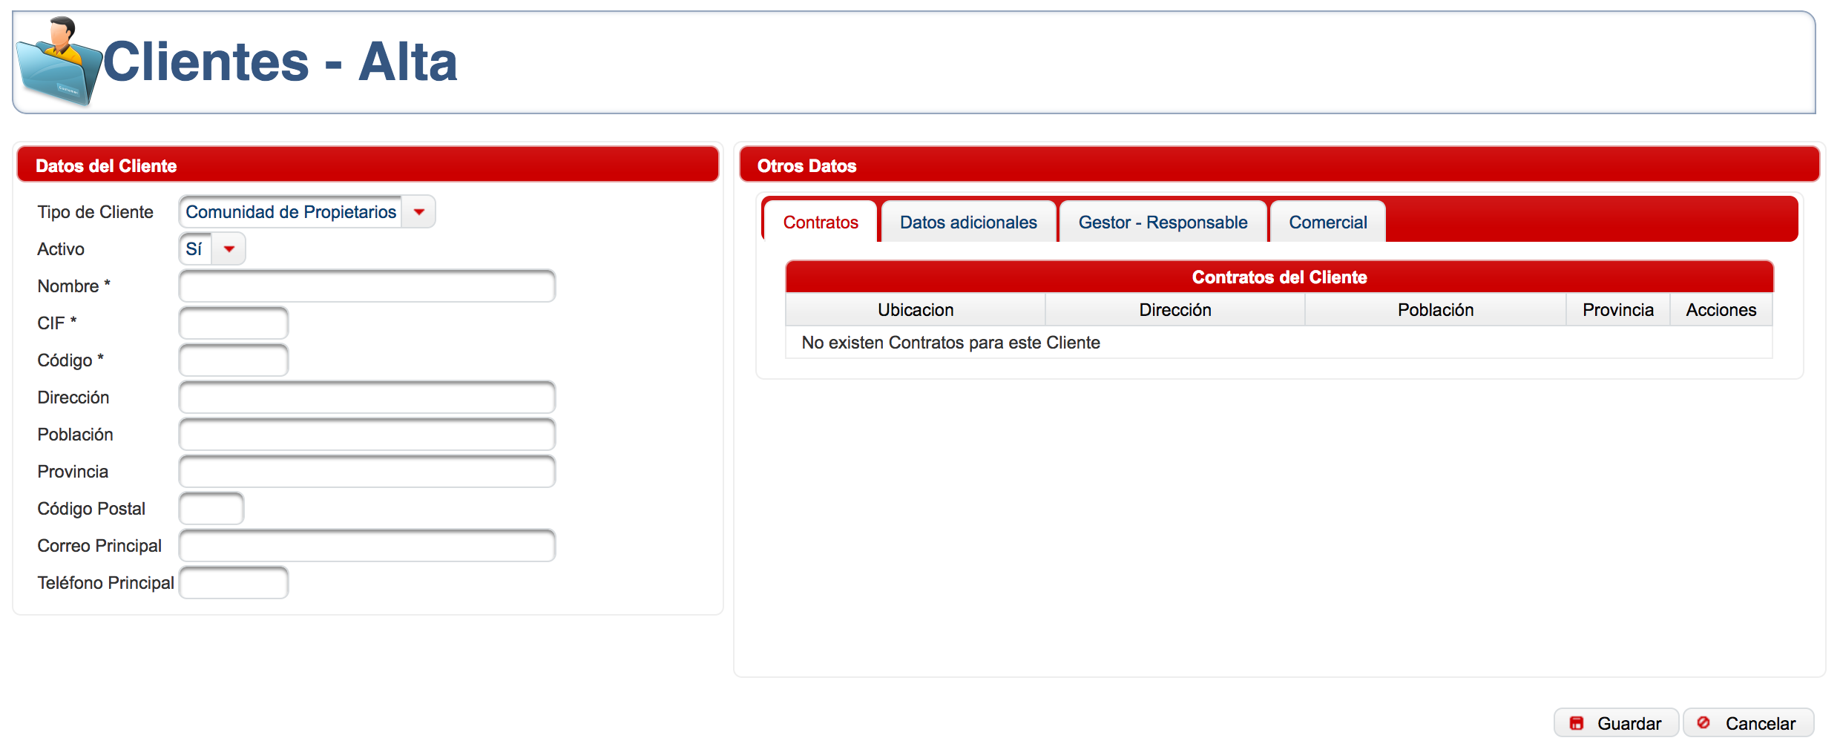
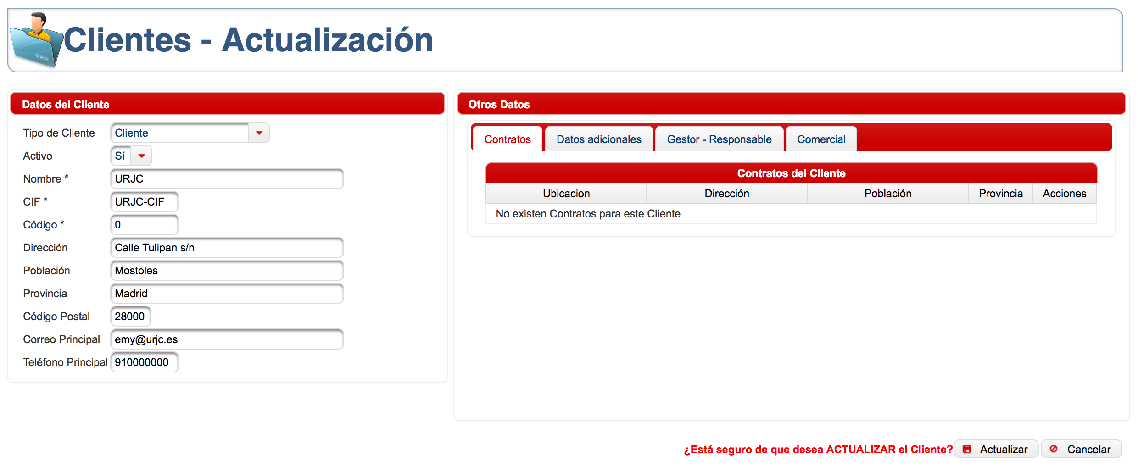
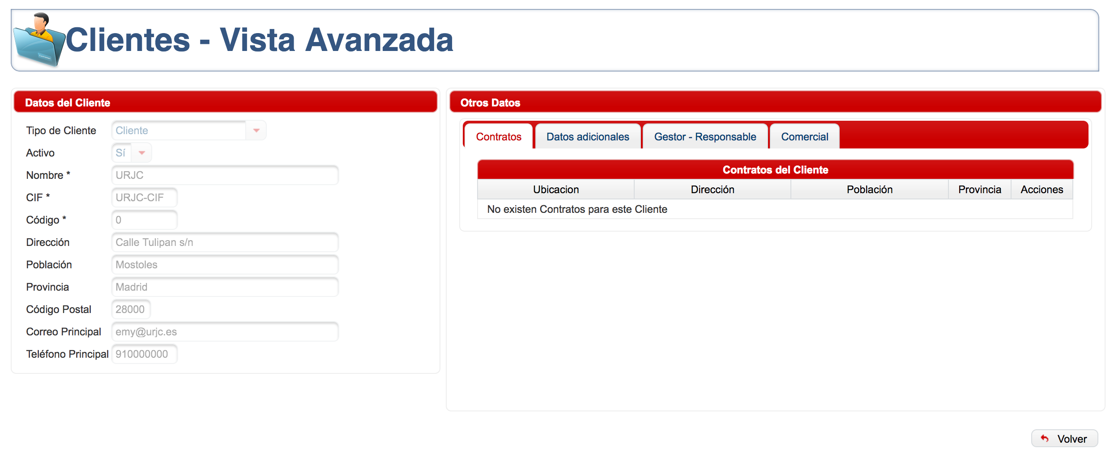
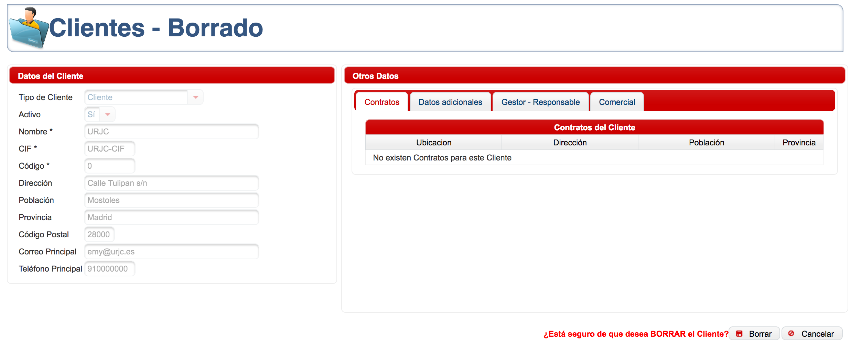
4. Design - View
JSF - PrimeFaces
Session Smart key
Configurable
Responsive
CSS

Slide 11
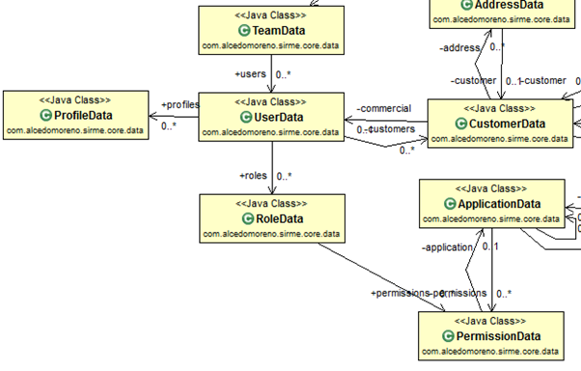
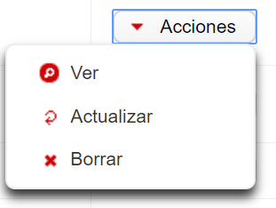
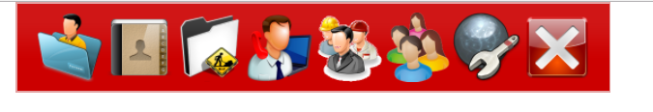
4. Design - Data Base

Slide 12
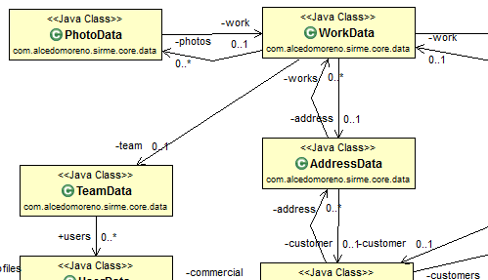
4. Design - Data Base

Slide 13
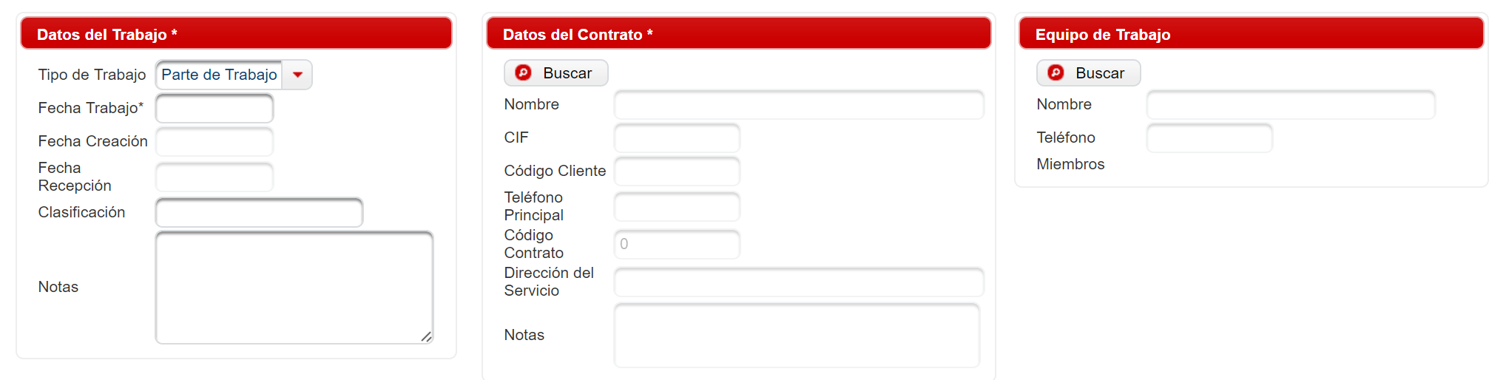
4. Design - Data Base

Slide 14
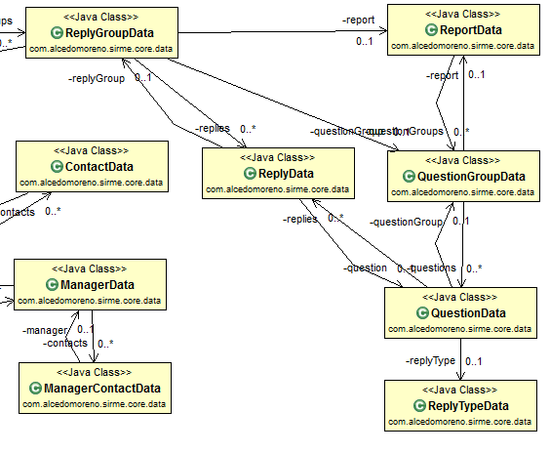
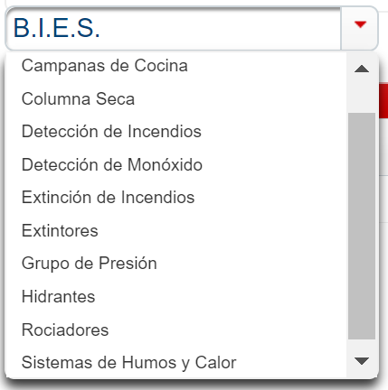
4. Design - Data Base

Slide 15
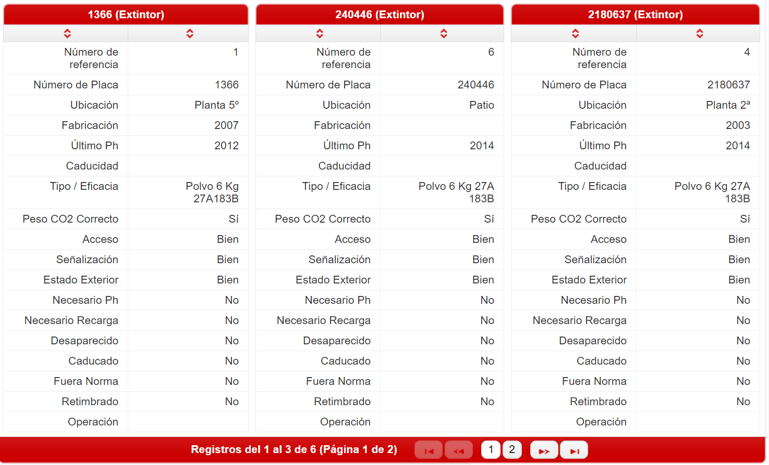
4. Design - Data Base

Slide 16
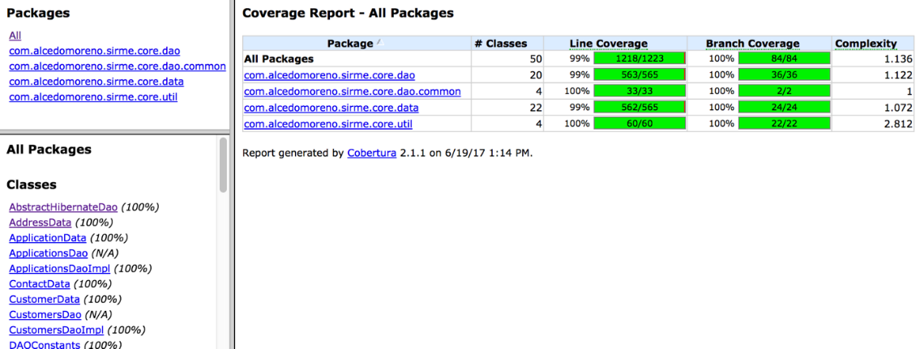
4. Design - Testing
Testing Is the Engineering Rigor of Software Development

Slide 17
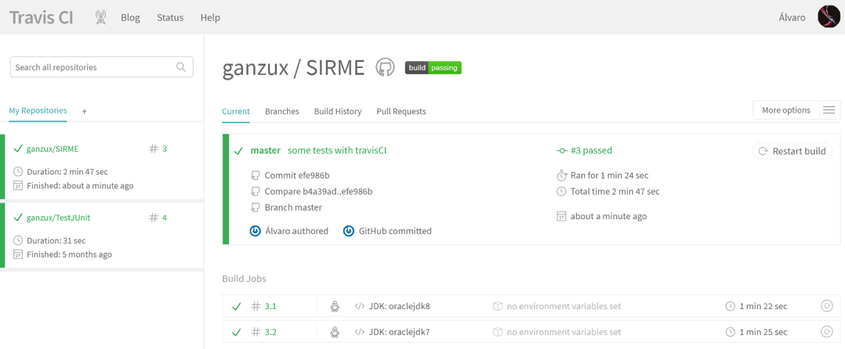
4. Design
Tests
JUnit
HyperSQL
Mocking
TravisCI

Slide 18

5. Conclusions
Possibility of using the system everywhere
Business adaptable
Expandable System
SaaS

Slide 19
5. Conclusions
THE PROCESS IS EASY!
Quick
Cheap
Adaptable

Slide 20
5. Conclusions
Did I see an improvement?
 | BEFORE SIRME | WITH SIRME
Average sheets per work | 12 | 1
Average kilometers per week and team | 1000+ | 500-
Average number of works done by week | 10 | 16

Slide 21
5. Conclusions
28.000+ sheets saved per year
120 new services per month
100%
That’s a lot of paper
And a lot of money
Total success!

Slide 22

6. Future Work
Auto Deploy - Real CI
Spring Boot
Resilience Tests, Stress Tests,
Performance Tests
Cucumber - BDD
Native mobile Apps

Slide 23

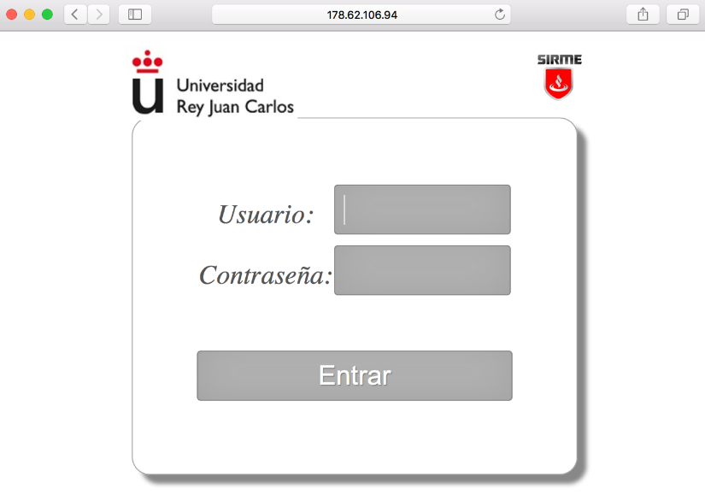
7. Demo?

Slide 24
THANKS!
Any questions?
You can find me at:
@ganzux
alvaro@alcedomoreno.com

